Slide 1

Frank-Wolfe method (and variants) applied to SVM
Camilo Betancourt Nieto

Slide 2
1. Contents
Contents
Formalization of the problem
Algorithms and implementation details
Datasets
Results and discussion

Slide 3
2. FORMALIZATION OF THE PROBLEM

Slide 4
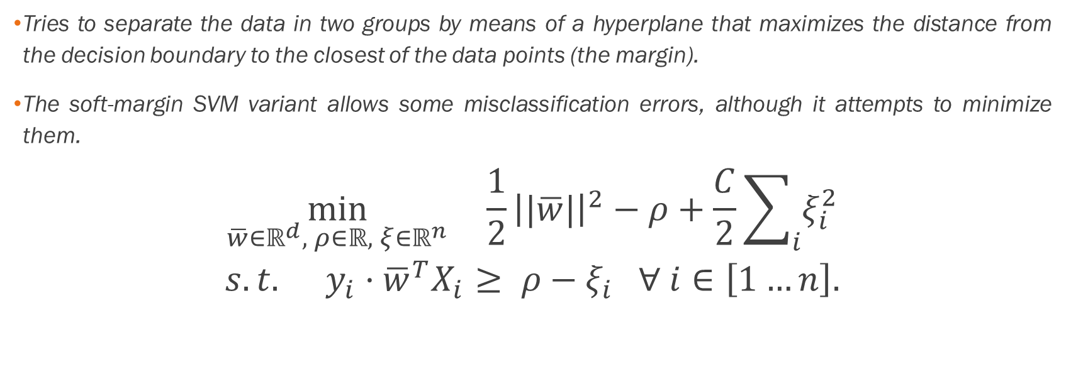
2.1. SOFT-MARGIN SVM
Tries to separate the data in two groups by means of a hyperplane that maximizes the distance from the decision boundary to the closest of the data points (the margin).
The soft-margin SVM variant allows some misclassification errors, although it attempts to minimize them.
$$\min_{\overline{w}∈ℝ^{d}, ρ∈ℝ, ξ∈ℝ^{n}}{\frac{1}{2}{\left||\overline{w}|\right|}^{2}−ρ+\frac{C}{2}\sum_{i}{ξ_{i}^{2}}}$$
$$s.t. y_{i}·{\overline{w}}^{T}X_{i}≥ ρ−ξ_{i} ∀ i∈\left[1…n\right].$$

Slide 5
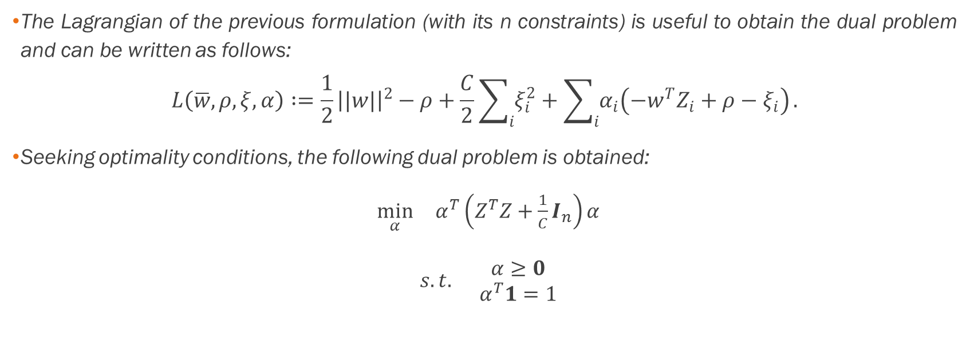
2.2 THE DUAL FORMULATION FOR A SOFT-MARGIN SVM
The Lagrangian of the previous formulation (with its n constraints) is useful to obtain the dual problem and can be written as follows:
$$L\left(\overline{w},ρ,ξ,α\right)∶=\frac{1}{2}{\left||w|\right|}^{2}−ρ+\frac{C}{2}\sum_{i}{ξ_{i}^{2}}+\sum_{i}{α_{i}\left(−w^{T}Z_{i}+ρ−ξ_{i}\right)}.$$
Seeking optimality conditions, the following dual problem is obtained:
$\min_{α}{α^{T}\left(Z^{T}Z+\frac{1}{C}I_{n}\right)α}$
$s.t. \begin{matrix}α≥0 \\ α^{T}1=1\end{matrix}$

Slide 6

2.2 THE DUAL FORMULATION FOR A SOFT-MARGIN SVM
The dual problem can be seen as an optimization problem of the form:
$$\min_{α∈△}{{\left||Aα|\right|}^{2}.}$$
where
$A∶=\left({Z \atop \frac{1}{\sqrt{C}}I_{n}}\right)∈ℝ^{\left(d+n\right)×n}.$
and:
$$△∶=\left\{x∈ℝ^{d} | x≥0 , \sum_{i}{x_{i}=1}\right\}=conv\left(\left\{1_{i}, i=1,…,d \right\}\right).$$

Slide 7

2.3 OBJECTIVE FUNCTION AND GRADIENT
Objective function:
$$f\left(α\right)={\left||Aα|\right|}^{2}={\left(Aα\right)}^{T}\left(Aα\right)=α^{T}A^{T}A α.$$
Gradient:
$$∇f\left(α\right)=2A^{T}Aα.$$

Slide 8
3. ALGORITHMS AND IMPLEMENTATION DETAILS

Slide 9
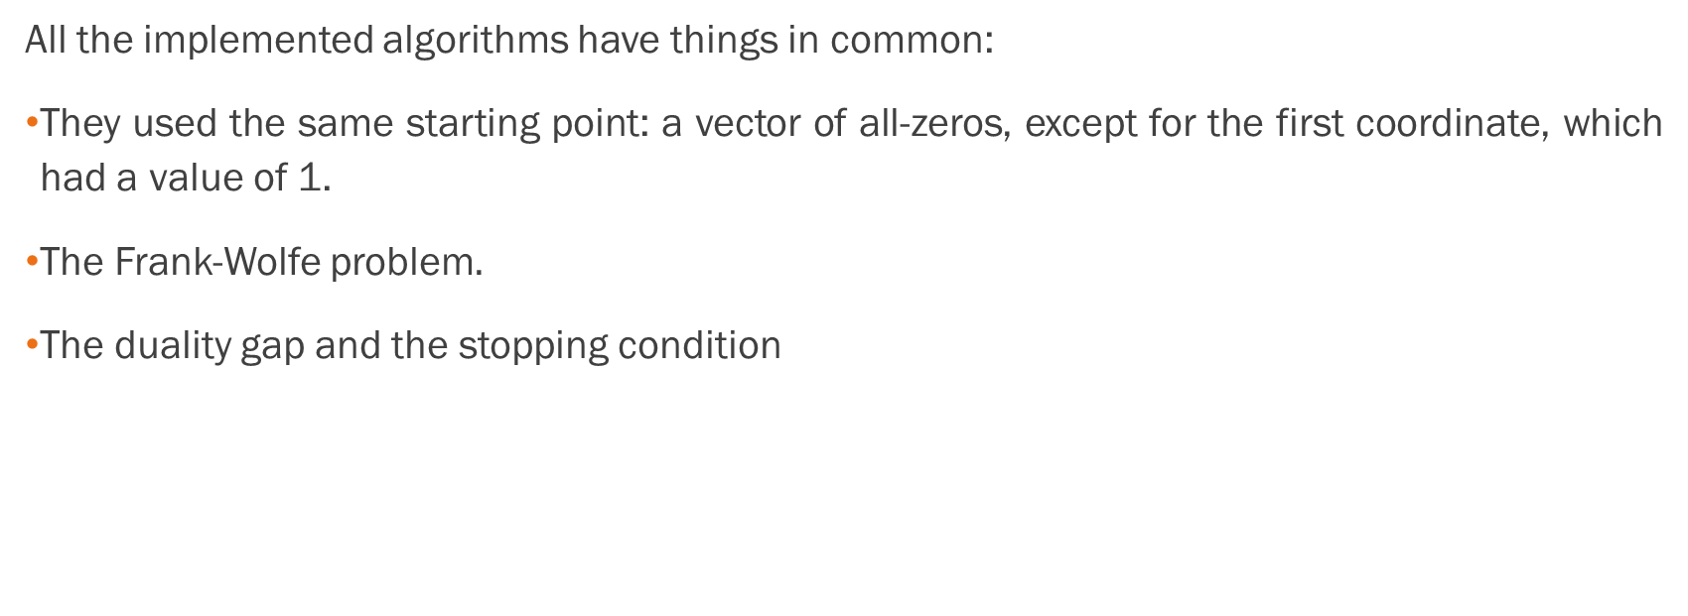
3.1 GENERAL CONSIDERATIONS
All the implemented algorithms have things in common:
They used the same starting point: a vector of all-zeros, except for the first coordinate, which had a value of 1.
The Frank-Wolfe problem$.$
The duality gap and the stopping condition

Slide 10

3.1.1 The Frank-Wolfe problem
Can be written as
$$\min_{α∈ △}{∇f{\left(α_{k}\right)}^{T}({α−α}_{k})}$$
and the optimal α∈ △ that solves the problem will be noted as $\hat{α}.$
Since at each iteration $α_{k}$ and $∇f(α_{k})$ are fixed Can be seen as a linear programming problem with the following form:
$\min_{α}{∇f{\left(α_{k}\right)}^{T}α}$
$s.t. \begin{matrix}α≥0 \\ α^{T}1=1\end{matrix}$
To obtain the optimal solution $\hat{α}∈ △$ it suffices to compute $∇f{\left(α_{k}\right)}^{T}α$ for all $α$ that are vertices and then selecting the minimum (O(d)).

Slide 11
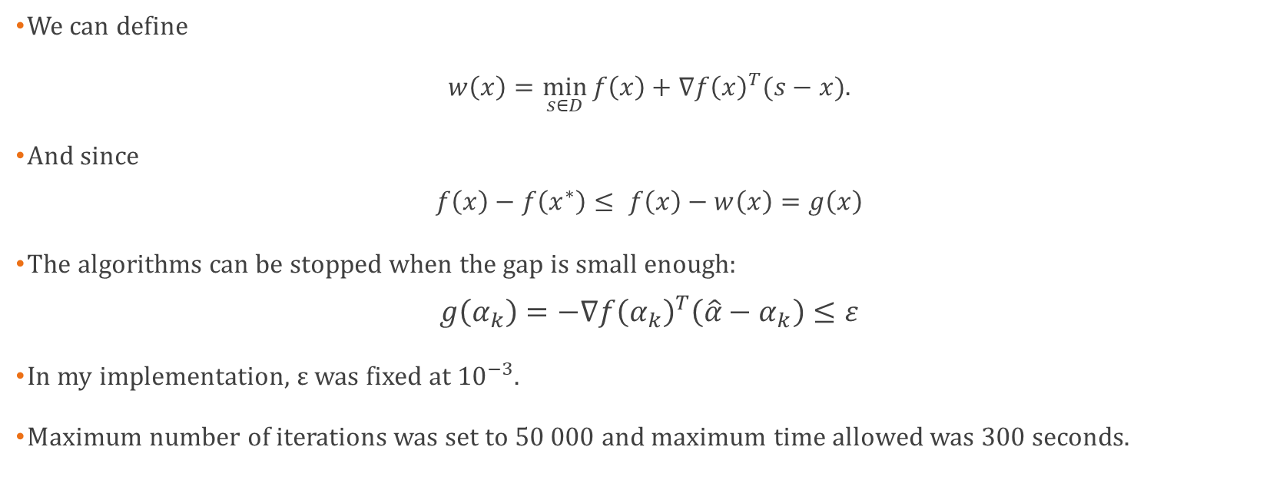
3.1.2 The duality gap and the stopping condition
We can define
$w\left(x\right)=\min_{s∈D}{f\left(x\right)+∇f{\left(x\right)}^{T}(s−x)}$.
And since
$$f\left(x\right)−f\left(x^{∗}\right)≤ f\left(x\right)−w\left(x\right)=g\left(x\right)$$
The algorithms can be stopped when the gap is small enough:
$$g\left(α_{k}\right)=−∇f{\left(α_{k}\right)}^{T}\left(\hat{α}−α_{k}\right)≤ε$$
In my implementation, $ε$ was fixed at ${10}^{−3}$.
Maximum number of iterations was set to 50 000 and maximum time allowed was 300 seconds.

Slide 12
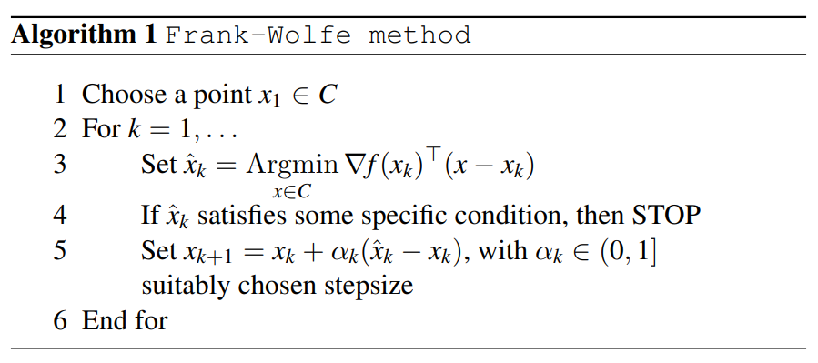

3.2 THE FRANK-WOLFE IMPLEMENTATION
For this project’s notation, $x corresponds to my α$ vector, while the picture’s $α$ is the step-size, which I call $β$):

Slide 13
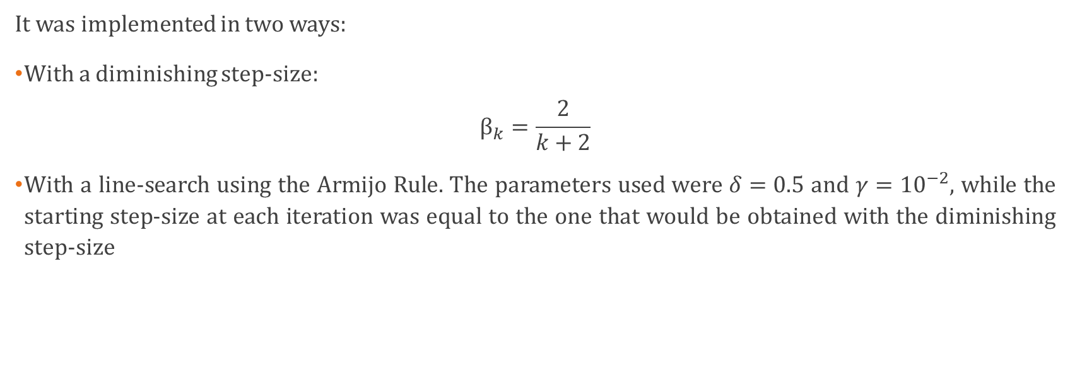
3.2 THE FRANK-WOLFE IMPLEMENTATION
It was implemented in two ways:
With a diminishing step-size:
$$β_{k}=\frac{2}{k+2}$$
With a line-search using the Armijo Rule. The parameters used were $δ=0.5$ and $γ={10}^{−2}$, while the starting step-size at each iteration was equal to the one that would be obtained with the diminishing step-size

Slide 14
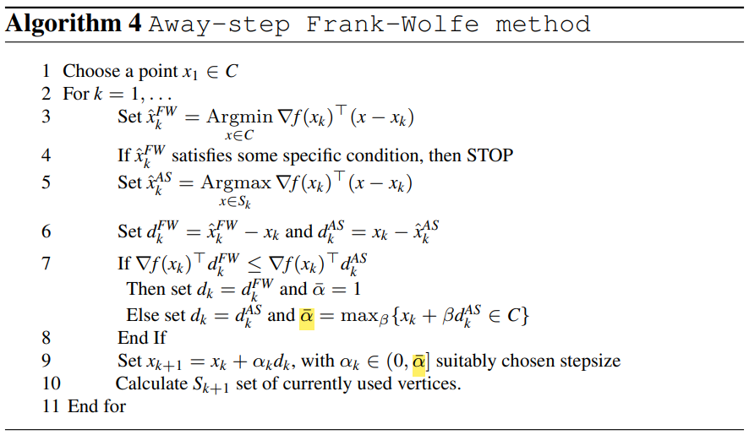
3.3 THE AWAY-STEPS FRANK-WOLFE IMPLEMENTATION

Slide 15
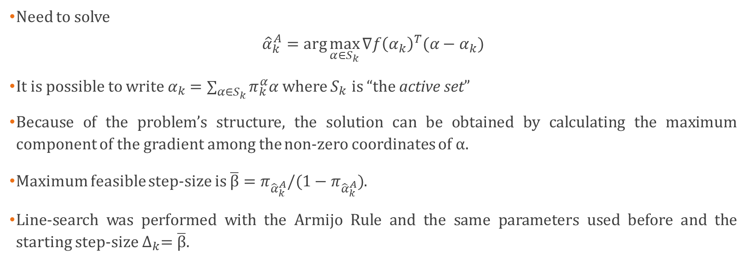
3.3 THE AWAY-STEPS FRANK-WOLFE IMPLEMENTATION
Need to solve
$${\hat{α}}_{k}^{A}=\arg{\max_{α∈S_{k}}{∇f{\left(α_{k}\right)}^{T}({α−α}_{k})}}$$
It is possible to write $α_{k}=\sum_{α∈S_{k}}{π_{k}^{α}α}$ where $S_{k}$ is “the active set”
Because of the problem’s structure, the solution can be obtained by calculating the maximum component of the gradient among the non-zero coordinates of α.
Maximum feasible step-size is $\overline{β}=π_{{\hat{α}}_{k}^{A}}/(1−π_{{\hat{α}}_{k}^{A}})$.
Line-search was performed with the Armijo Rule and the same parameters used before and the starting step-size $∆_{k}=\overline{β}.$

Slide 16

3.4 THE PAIRWISE FRANK-WOLFE IMPLEMENTATION
Like Away-steps Frank-Wolfe but:
Direction is computed as $d_{k}=d_{k}^{FW}+d_{k}^{A}$.
Maximum feasible step-size differs and is set to $\overline{β}=π_{{\hat{α}}_{k}^{A}}$.
Line-search was also performed with the Armijo Rule and the same parameters as before$.$

Slide 17
4. Datasets

Slide 18
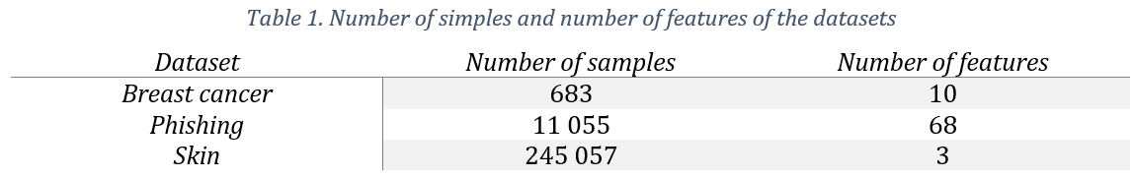
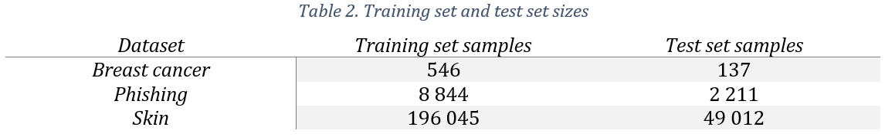
4. DATASETS

Slide 19
5. RESULTS AND DISCUSSION

Slide 20
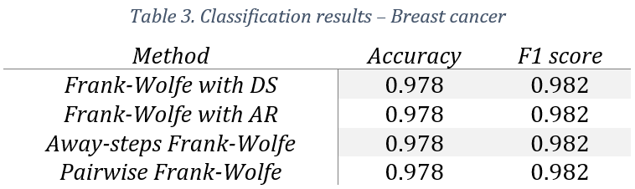
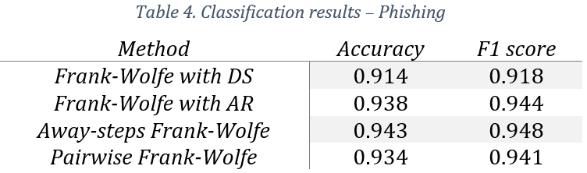
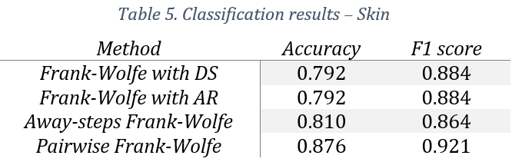
5.1 CLASSIFICATION RESULTS

Slide 21
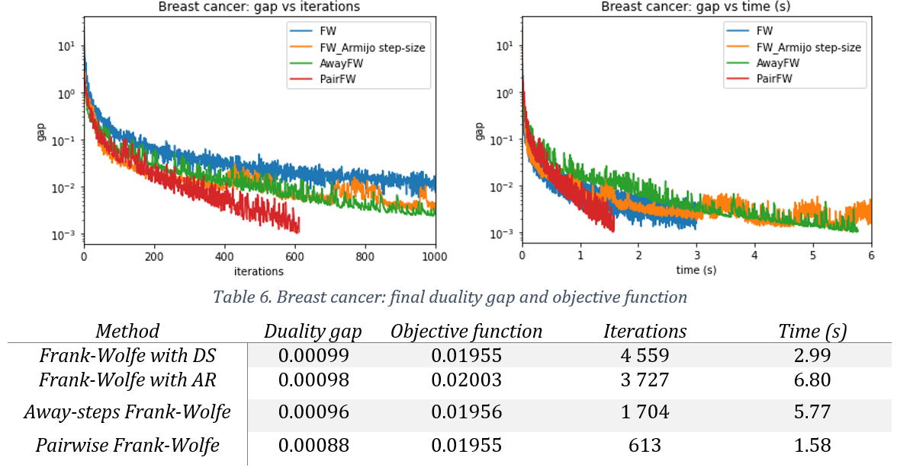
5.2 OPTIMIZATION RESULTS

Slide 22
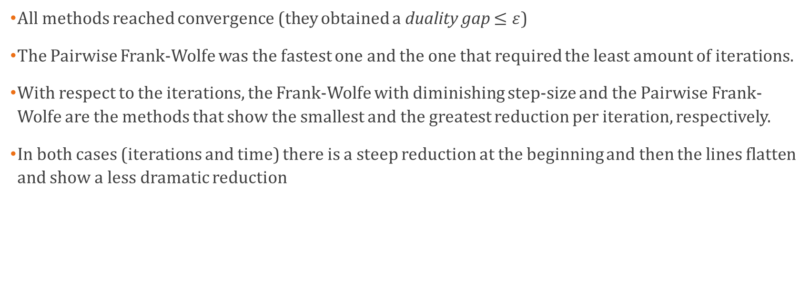
5.2 OPTIMIZATION RESULTS
All methods reached convergence (they obtained a duality gap $≤ε$)
The Pairwise Frank-Wolfe was the fastest one and the one that required the least amount of iterations.
With respect to the iterations, the Frank-Wolfe with diminishing step-size and the Pairwise Frank-Wolfe are the methods that show the smallest and the greatest reduction per iteration, respectively.
In both cases (iterations and time) there is a steep reduction at the beginning and then the lines flatten and show a less dramatic reduction

Slide 23
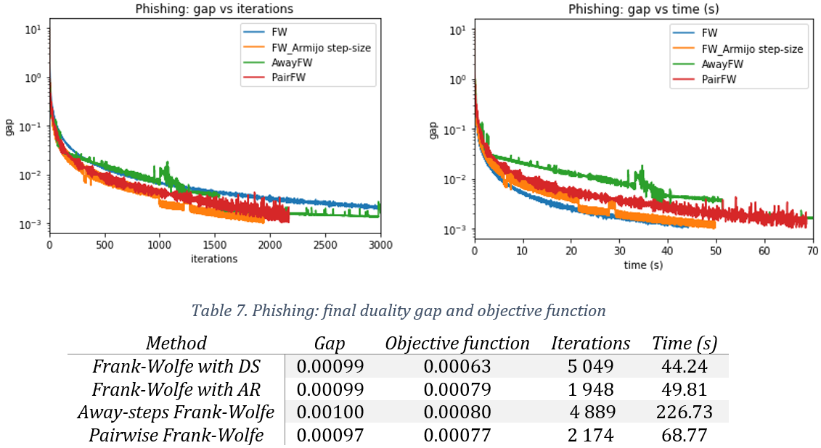
5.2 OPTIMIZATION RESULTS

Slide 24
5.2 OPTIMIZATION RESULTS
The iterations vs duality gap plot shows a similar behavior as before, although the Pairwise Frank-Wolfe is not as efficient as in the previous case.
The time vs duality gap plot indicates that the original Frank-Wolfe (with both step-size approaches) stopped before the implemented variants
Even though all methods reached convergence again, what stands out for the Phishing data is that the Frank-Wolfe with Armijo Rule was surprisingly efficient.
The direction obtained with the Pairwise Frank-Wolfe algorithm seems to result in better performance compared to the Away-steps Frank-Wolfe variant

Slide 25
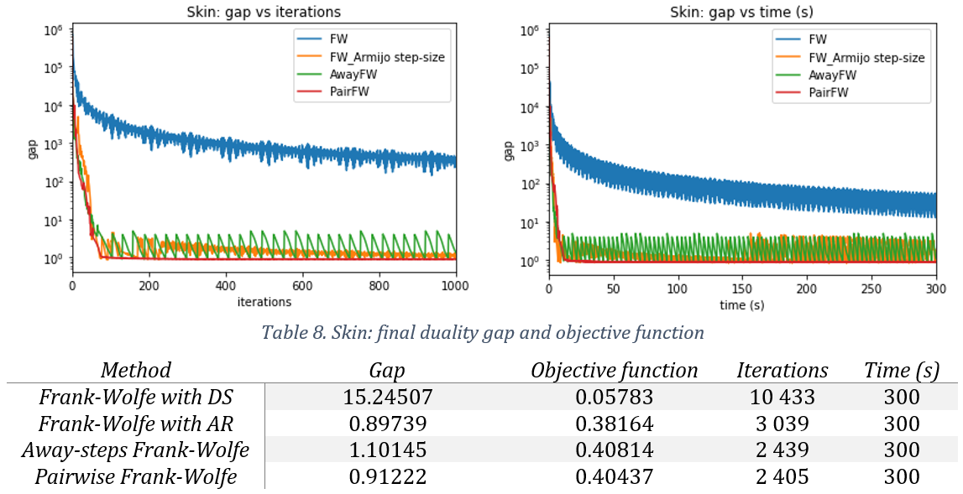
5.2 OPTIMIZATION RESULTS

Slide 26
5.2 OPTIMIZATION RESULTS
In both plots it is evident that the Frank-Wolfe with diminishing step-size is the least efficient method in terms of iterations and time.
Unlike the other methods, the Pairwise Frank-Wolfe shows a less bumpy optimization process
Even though none of the methods reached full convergence for the established time budget, the algorithms that resulted in the smallest duality gaps were the Frank-Wolfe with Armijo Rule and the Pairwise Frank-Wolfe

Slide 27
5.3 General conclusions
Implementing the Armijo Rule approach, instead of using the diminishing step-size for the Frank-Wolfe results in a better performing algorithm.
It appears that in this experiment the Frank-Wolfe variants do improve the original method, as the theory suggests (given that the variants are designed to avoid the zig-zag effect of the original algorithm)
The Pairwise Frank-Wolfe showed a more consistent performance than the Away-steps Frank-Wolfe in terms of iterations and time efficiency

